Slide 1
Issuing Adjustable Rate Mortgage (ARM)
Pool Types
In SFPDM
May 2023

Slide 2
agenda
3 - 4 | Introduction
5 - 6 | Single Family Adjustable Rate (ARM) Pool Types
7 | Prerequisites for Pooling
8 - 9 | Path of the Pool
10 | Demo - Issuing ARM Pools in SFPDM
11 | Quick Tips
12 | Resources & Support
13 | Q&A

Slide 3
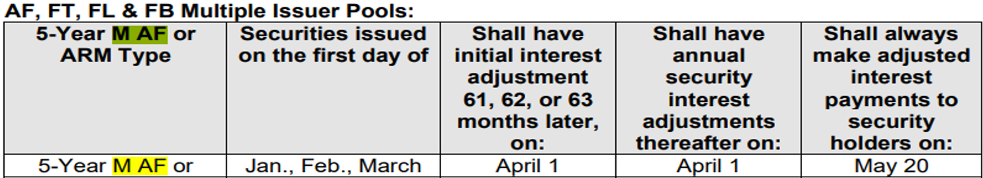
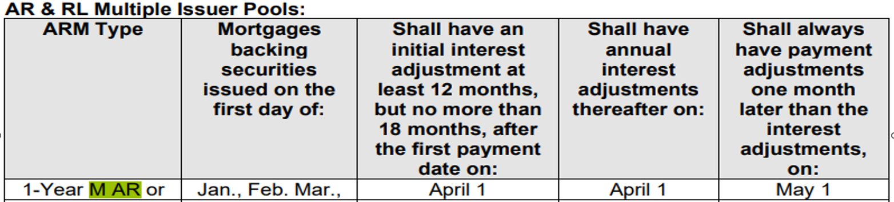
OVERVIEW - ADJUSTABLE RATE MORTAGE POOL TYPES
Below are descriptions of the “M AF” and “M AR” Single Family Adjustable Rate Mortgage Pool types.
“M AF” identifies a 5-Year hybrid ARM multiple Issuer pool or loan package with a “1/5” interest rate cap structure. The first interest adjustment date for each mortgage must occur at least 60 months, but not more than 66 months, after the first payment date on the mortgage. The first interest adjustment date for the securities must occur from 61 to 63 months after the issue date.
“M AR” identifies a 1-Year ARM multiple Issuer pool or loan package. The first interest adjustment date for each mortgage must occur at least 12 months, but not more than 18 months, after the first payment date on the mortgage. The first interest adjustment date for the securities must occur from 13 to 15 months after the issue date;

Slide 4
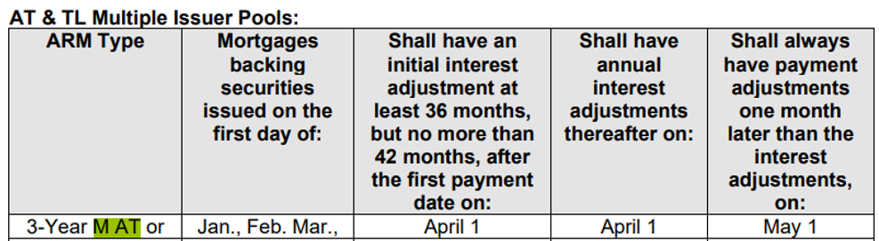
OVERVIEW - ADJUSTABLE RATE MORTAGE POOL TYPES (cont.)
Below is a description of the “M AT” Single Family Adjustable Rate Mortgage Pool type.
“M AT” identifies a 3-Year hybrid ARM multiple Issuer pool or loan package. The first interest adjustment date for each mortgage must occur at least 36 months, but not more than 42 months, after the first payment date on the mortgage. The first interest adjustment date for the securities must occur from 37 to 39 months after the issue date;

Slide 5
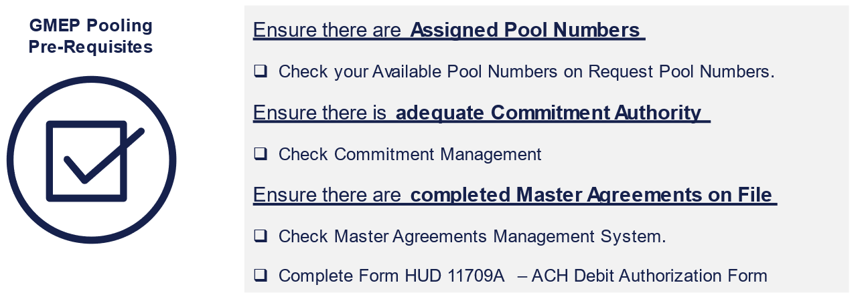
Prerequisites for pooling
Below are Pre-Pool Submission Requirements for Issuers submitting Pools in SFPDM.

Slide 6
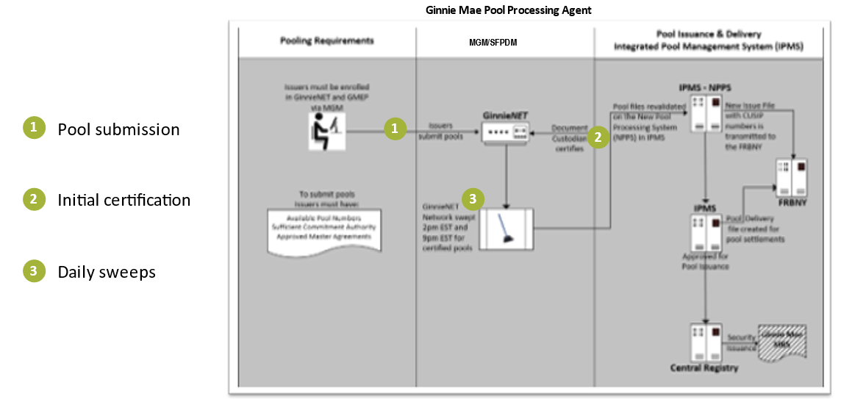
Path of the pool
Pool submission, Processing, Issuance & Delivery Diagram

Slide 7



Path of the pool
The information below provides details for Initial Certification of Pool/Loan packages in SFPDM.
The SFPDM network is swept twice each business day for processing and issuance of pools certified by the Document Custodian.
2:00PM SWEEP
Certified Pools/Loan Packages
9:00PM SWEEP
Certified Pools/Loan Packages
Pools Certified Prior to 2:00 PM EST
Pools Certified After 2:00PM EST but before 9:00PM EST
Will be considered Day Processing and may be delivered for settlement on the next business day.
Will be considered 2-Day Processing and may be delivered for settlement in two (2) business days.
Recalling Pools After Certification
Pools can only be deleted between the hours of 2:00PM – 4:00PM EST by the PPA.
Contact Ginnie Mae Customer Support at
1-833-466-2435
Issuers have until
12:00PM to perform Auto-Recall in SFPDM.
for assistance with deleting pools after 12:00PM but before 4:00PM EST
Issuers must contact Ginnie Mae Customer Support at
1-833-466-2435

Slide 8
Quick tips
Tips of Issuers creating SFPDM pools
  Importing SFPDM Pools
  Multiple Issuers under profile
  Importing pools will save time when creating large pools.
  Make sure to select the correct Issuer Number when pooling, if the account has multiple organizations.
  Advanced Filter
  Sufficient Commitment
  Are useful when trying to search for specific pools.
  Make sure you have sufficient commitment before issuing a pool(s).
  Skittles
  TAI/PITT Pool
  Are useful to view different status and number of pools.
  You are now able to accept TAI pools on the Dashboard.

Slide 9


Resources & support
GinnieMae MBS Guide https://www.ginniemae.gov/issuers/program_guidelines/MBSGuideLib/Chapter_26.pdf#search=M%20AT
SFPDM User Manual https://www.ginniemae.gov/issuers/issuer_training/Tools%20and%20Resources/sfpdm_user_manual.pdf
SFPDM QRC’s
https://www.ginniemae.gov/issuers/issuer_training/pages/qrcs.aspx
Ginnie Mae Customer Support
Support Mailboxes
1-833-466-2435, option 1
ginniemae1@bnymellon.com

